Slide 1

Software Engineering Course Code : 210253

Slide 2

Course Objectives
To learn and understand the principles of software engineering
To be acquainted with methods of capturing, visualising and analysing software requirements
To apply design and testing principles to software project management
To understand project management through life of the project

Slide 3
Course Outcomes
CO_1: Analyze software requirements and formulate design solution for a software.
CO_2: Design applicable solutions in one or more application domains using software engineering approaches that integrate ethical, social, legal and economic concerns.
CO_3: Apply new software models, techniques and technologies to bring out innovative and novelistic solutions for the growth of the society in all aspects and evolving into their continuous professional development.
CO_ b4: Model and design User interface and component-level.
CO5: Identify and handle risk management and software configuration management.
C06: Utilize knowledge of software testing approaches, approaches to verification and validation.
C07: Construct software of high quality — software that is reliable, and that is reasonably easy to understand, modify and maintain efficient, reliable, robust and cost-effective software solutions.

Slide 4
Books
Software Engineering: A Practitioner‘s Approach by Roger Pressman, McGraw Hill Publication
Ian Sommerville, ― Software Engineeringǁ, Addison and Wesley Publication

Slide 5
Unit 1:
Introduction to Software Engineering, Software Process Models

Slide 6
Objectives
Software Engineering Fundamentals:
Introduction to software engineering,
The Nature of Software, Defining Software, Software Engineering Practice.
Software Process:
A Generic Process Model,
defining a Framework Activity,
Identifying a Task Set,
Process Patterns,
Process Assessment and Improvement,
Prescriptive Process Models,
The Waterfall Model,
Incremental Process Models,
Evolutionary Process Models,
Concurrent Models,
A Final Word on Evolutionary Processes.
Unified Process,
Agile software development: Agile methods, plan driven and agile development.

Slide 7

Introduction – What is Software?
Software is:
Instructions (computer programs) that when executed provide desired features, function, and performance
Data structures that enable the programs to adequately manipulate information
Documentation that describes the operation and use of the programs
Software is both a product and a vehicle that delivers a product(e.g. Operating System)
7

Slide 8

What is Software ?
Software is a product
Transforms information - produces, manages, acquires, modifies, displays, or transmits information
Delivers computing potential of hardware and networks Software is a vehicle for delivering a product
Controls other programs (operating system)
Effects communications (networking software)
Helps build other software (software tools & environments)
8

Slide 9

What is Software ?
Software products may be developed for a particular customer or may be developed for a general market.
Software products may be
Generic - developed to be sold to a range of different customers e.g. PC software such as Excel or Word.
Bespoke (custom) - developed for a single customer according to their specification. E.g. air traffic monitoring

Slide 10

Definition of software
Software is ..
Instructions that when executed provide desired features, function and performance
Data structures that enable the program to manipulate information.
Documentations or descriptive information in hard copy and virtual forms that describes the operation and use of programs

Slide 11

Software Engineering Definition
The IEEE definition:
Software Engineering: The application of a systematic, disciplined, quantifiable approach to the development, operation, and maintenance of software; that is, the application of engineering to software.
Engineering approach to
Develop software.
Building Construction Analogy.
Systematic collection of past experience:
Techniques,
Methodologies,
Guidelines.

Slide 12


A Layered Technology
Software engineering is a layered technology
Any engineering approach (including software
Engineering) must rest on an organizational commitment to quality.
TQM, Six Sigma or any similar philosophies foster a continuous process improvement culture, and it is this culture that ultimately leads to the development of increasingly more effective approaches to software engineering.
The bedrock that supports software engineering is a quality focus.

Slide 13

Layered Technology
Foundation layer is Process Layer
Definition of Process : a series of actions or steps taken in order to achieve a particular end.
Process Model : A framework i.e. responsible for milestones, quality, work products
Methods: Technical ― “how to” s. Methods encompass a broad array of tasks that include communication, requirements analysis, design modeling, program construction, testing, and support.
Tools : Automated or simulated support for s/w development. When tools are integrated so that information created by one tool can be used by another, a system for the support of software development, called computer-aided software engineering, is established.

Slide 14

Software Process
A process is a collection of activities, actions and tasks to create a work product.
An activity strives to achieve a broad objective (e.g., communication with stakeholders) and is applied regardless of the application domain, size of the project, complexity of the effort
An action (e.g., architectural design) encompasses a set of tasks that produce a major work product (e.g., an architectural design model)
A task focuses on a small, but well-defined objective (e.g., conducting a unit test) that produces a tangible outcome
14

Slide 15

Software Process
A process is not a rigid prescription for how to build computer software.
The intent is always to deliver software in a timely manner and with sufficient quality to satisfy those who have sponsored its creation and those who will use it.
Includes umbrella activities which protect and control the process.
Process Framework has 5 activities:
Communication
Planning
Modeling
Construction (Implementation)
Deployment

Slide 16

Process Framework
Communication : The intent is to understand stakeholders’ objectives for the project and to gather requirements that help define software features and functions.
Heavy communication with customers, stakeholders,
team Encompasses requirements gathering and
related activities
Planning : defines the software engineering work by describing the technical tasks to be conducted, the risks that are likely, the resources that will be required, the work products to be produced, and a work schedule.
Workflow that is to follow
Describe technical task, likely risk, resources will require, work products to be produced and a work schedule

Slide 17

Modeling : A software engineer create models to better understand software requirements and the design that will achieve requirements.
Help developer and customer to understand requirements (Analysis of requirements) & Design of software
Construction : This activity combines code generation (either manual or automated) and the testing that is required to uncover errors in the code
Code generation: either manual or automated or both
Testing – to uncover error in the code

Slide 18
Deployment : The software (as a complete entity or as a partially completed increment) is delivered to the customer who evaluates the delivered product and provides feedback based on the evaluation
Delivery to the customer for evaluation
Customer provide feedback

Slide 19
Software Process
Software project tracking and control—allows the software team to assess progress against the project plan and take any necessary action to maintain the schedule.
Risk management—assesses risks that may affect the outcome of the project or the quality of the product.
Software quality assurance — defines and conducts the activities required to ensure software quality.
Technical reviews—assesses software engineering work products in an effort to uncover and remove errors before they are propagated to the next activity

Slide 20
Measurement—defines and collects process, project, and product measures that assist the team in delivering software that meets stakeholders’ needs; can be used in conjunction with all other framework and umbrella activities.
Software configuration management— manages the effects of change throughout the software process.
Reusability management—defines criteria for work product reuse (including software components) and establishes mechanisms to achieve reusable components.
Work product preparation and production —encompasses the activities required to create work products such as models, documents, logs, forms, and lists.
19

Slide 21
Software Engineering Practice
Understand the problem (communication and analysis)
Plan the solution (modeling and software design).
Carry out the plan (code generation).
Examine the result(testing and quality assurance).
20

Slide 22
Generic Process Model
Process is a collection of activities, actions and tasks for a work product to be created.
All these reside within a framework or a model that define the relationship with the process and with one another.
Software Process is represented in the figure.
There can be linear, iterative, evolutionary or parallel process flows executing framework activities.
21

Slide 23
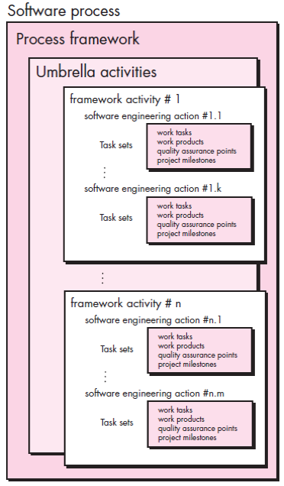

Slide 24

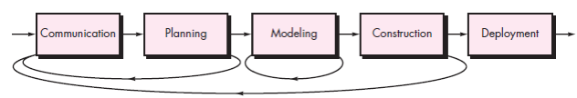
Process Flow
Linear Process Flow : Executes flow from communication to deployment in sequence
Iterative Process Flow
22

Slide 25
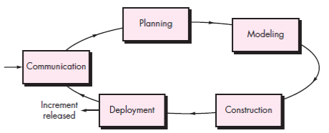
Evolutionary Process Flow : Executes the activities in a ―circular manner to provide a software version
23

Slide 26

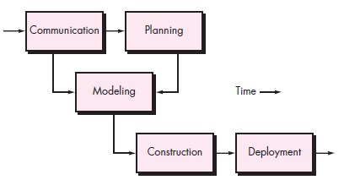
Parallel Process Flow: Executes one or more activities in parallel with other activities

Slide 27
Types of Process Models
Generic Process Model
Prescriptive Process Model
Evolutionary Process Model

Slide 28
1) Generic Process Model
A generic process model has:
1.Defining a framework activity:
Work tasks for a simple software project are:
Make contact with stakeholder via telephone.
Discuss requirements and take notes.
Organize notes into a brief written statement of requirements.
E-mail to stakeholder for review and approval.
If Project is complex, then go for: inception, elicitation, elaboration, negotiation, specification, and validation.
2. Identifying a task set:
Task sets are actual list of work to be done to accomplish the objective of s/w engg. action.
Select suitable task set based on problem and project.
3. Process patterns: Proven solutions for the similar problems

Slide 29
2) Prescriptive Process Models
It define a prescribed set of process elements and a predictable process work flow.
Organize framework activities in a certain order
Process framework activity with set of software engineering actions.
Each action in terms of a task set that identifies the work to be accomplished to meet the goals.
The resultant process model should be adapted to accommodate the nature of the specific project, people doing the work, and the work environment.
Calling this model as “Prescribe” because it recommend a set of process elements, activities, action task, work product & quality.
Each elements are inter related to one another (called workflow).

Slide 30

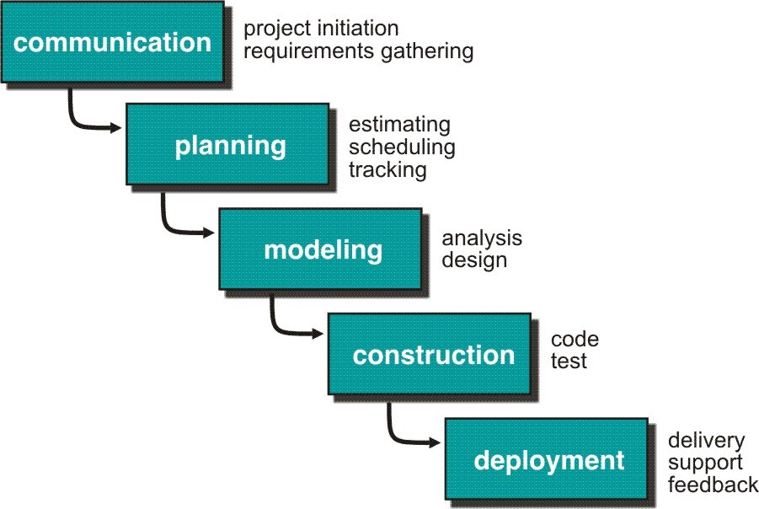
2.1) Waterfall Model or Classic Life Cycle
A systematic, sequential approach to software development that begins with customer specification of requirements and progresses through planning, modeling, construction, and deployment, culminating in ongoing support of the completed software

Slide 31

Requirement Analysis and Definition: What - The systems services, constraints and goals are defined by customers with system users.
Scheduling tracking -
Assessing progress against the project plan.
Require action to maintain schedule.
System and Software Design: How –It establishes and overall system architecture. Software design involves fundamental system abstractions and their relationships.
30

Slide 32

Integration and system testing: The individual program unit or programs are integrated and tested as a complete system to ensure that the software requirements have been met. After testing, the software system is delivered to the customer.
Operation and Maintenance: Normally this is the longest phase of the software life cycle. The system is installed and put into practical use. Maintenance involves correcting errors which were not discovered in earlier stages of the life-cycle.
31

Slide 33
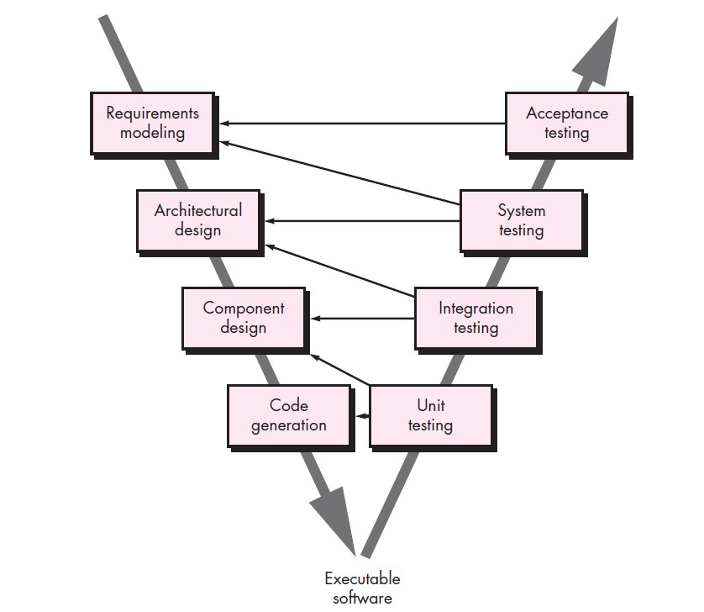
2.2) V-Model

Slide 34
Disadvantages:
The nature of the requirements will not change very much During development; during evolution
The model implies that you should attempt to complete a given stage before moving on to the next stage
Does not account for the fact that requirements constantly change.
It also means that customers can not use anything until the entire system is complete.
The model implies that once the product is finished, everything else is maintenance.
Surprises at the end are very expensive Some teams sit ideal for other teams to finish
Therefore, this model is only appropriate when the requirements are well- understood and changes will be fairly limited during the design process.

Slide 35
Problems:
Real projects are rarely follow the sequential model.
Difficult for the customer to state all the requirement explicitly.
Assumes patience from customer- working version of program will not available until programs not getting change fully.

Slide 36

2.3) Incremental Process Model
This is used when there is a need to provide limited set of software functionality to users quickly and then refine and expand that functionality in later software releases
When an incremental model is used, the first increment is often a core product
The incremental process model focuses on the delivery of an operational product with each increment
Staffing, delivery date and resources are managed.
Disadvantages:
Each phase is rigid and no overlapping.
Not all requirements are gathered up at once. Problems may arise

Slide 37
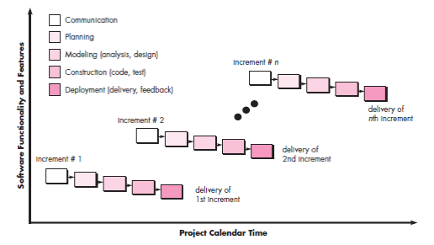
Incremental Process Model (Ex: The Ready And Deliver Model)
Delivers software in small but usable pieces, each piece builds on pieces already delivered
36

Slide 38

3) Evolutionary Process Models
Evolutionary process models produce an increasingly more complete version of the software with each iteration.
They are different from incremental model as the requirements keep on changing here.
Evolutionary models are iterative.
Examples include :
Prototyping
Spiral Model
Concurrent Development Model
37

Slide 39
Prototyping :
The Software Prototyping refers to building
software application prototypes which displays the functionality of the product under development, but may not actually hold the exact logic of the original software
Developing a prototype based on the stakeholders requirements.
Unsure of the algorithm implemented.
Many systems are built one after the other.
Major of them are throw aways
Evolutionary Process Models
38

Slide 40
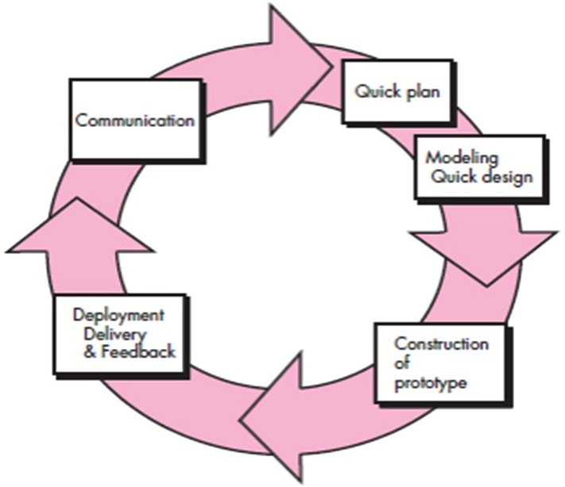
Evolutionary Process Models

Slide 41
Best approach when:
Objectives defined by customer are general but does not have details like input, processing, or output requirement.
Developer may be unsure of the efficiency of an algorithm, O.S., or the form that human machine interaction should take.
It can be used as standalone process model.
Model assist software engineer and customer to better understand what is to be built when requirements are fuzzy.
Prototyping start with communication, between a customer and software engineer to define overall objective, identify requirements and make a boundary.
39

Slide 42
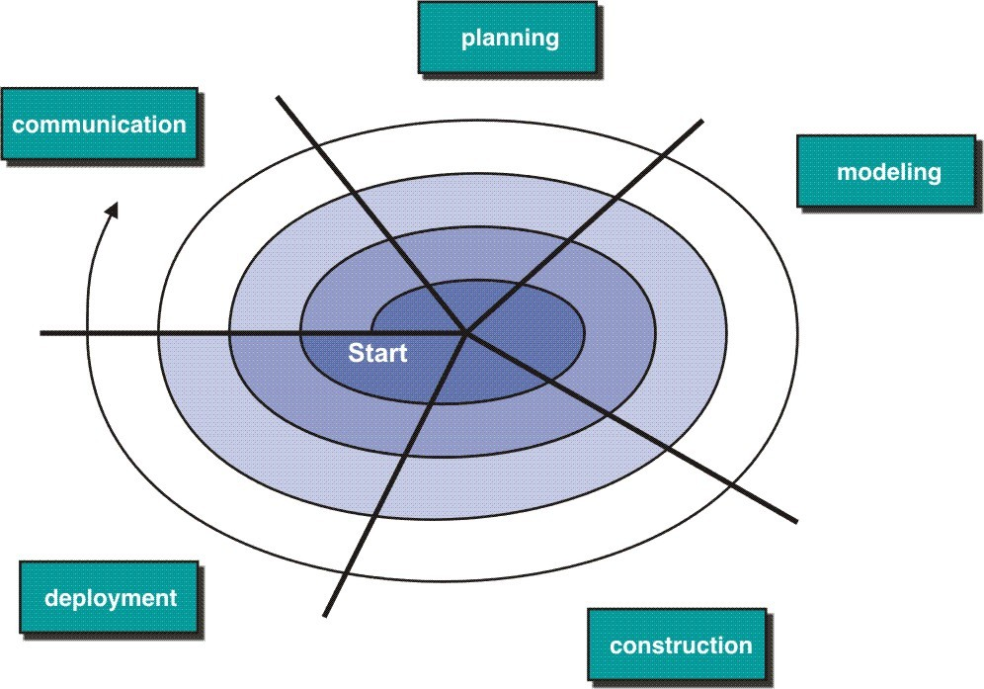
Spiral Model
Evolutionary Process Models

Slide 43

The spiral model is an evolutionary software process model that couples the iterative nature of prototyping with the controlled and systematic aspects of the waterfall model.
It provides potential for rapid development of increasingly more complete version of the software.
Using spiral, software developed in as series of evolutionary release.
Early iteration, release might be on paper or prototype.
Later iteration, more complete version of software.
Evolutionary process begins in a clockwise direction, beginning at the center risk
Each loop/pass through the spiral model consists of risk assessment and other framework activities from communication through deployment

Slide 44
First circuit around the spiral might
result in development of a product
specification
Subsequently, develop a prototype and then progressively more sophisticated version of software.
Unlike other process models that end when software is delivered.
It can be adapted to apply throughout the life of software.
It maintains the systematic stepwise approach suggested by the classic life cycle but also incorporates it into an iterative framework activity.
If risks cannot be resolved, project is immediately terminated
42

Slide 45

Disadvantages:
Can be a costly model to use.
Risk analysis requires highly specific expertise.
Project’s success is highly dependent on the risk analysis phase.
Doesn’t work well for smaller projects
It may be difficult to convince customers (particularly in contract situations) that the evolutionary approach is controllable.
If a major risk is not uncovered and managed, problems will undoubtedly occur.
43

Slide 46

Concurrent Process Models
The concurrent model is often more appropriate for product engineering projects where different engineering teams are involved.
In simple words, here, the stages run simultaneously rather than consecutively, with multiple teams working on them.
They run concurrently but reside in different states
44

Slide 47
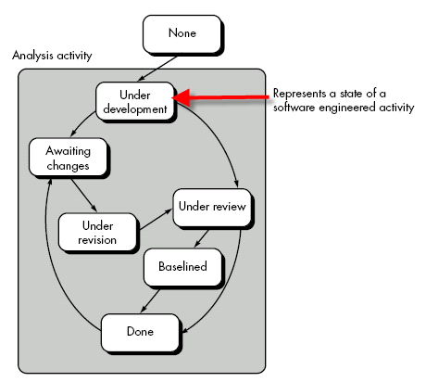
Concurrent Development Model
45

Slide 48

Concurrent Development
Visibility of current state of project
It define network of activities
Each activities, actions and tasks on the network exists simultaneously with other activities ,actions and tasks.
Events generated at one point in the process network trigger transitions among the states.

Slide 49
Disadvantages:
Large upfront investment
Implementation of early design reviews
Dependency on efficient communication
Software compatibility and need for computer modeling

Slide 50

Unified Process
It can be defined as ―object oriented, use case driven, architecture-centric, iterative and incremental software process.
It is a popular iterative and incremental software development process framework.
It is a combination of best features of object oriented analysis and design methods.
This resulted in a robust notation of modeling and design i.e., UML-Unified Modeling Language.

Slide 51
Unified Process :Use case driven, architecture-centric, iterative and incremental” software process
“Unified Method” that would combine the best features of each of their individual object-oriented analysis and design methods and adopt additional features in object-oriented Modeling.
The result was UML—a unified modeling language that contains a robust
notation for the modeling and development of object-oriented systems

Slide 52

Unified Process has 5 phases as seen in generic process model :
1) Inception Phase :
The inception phase of the UP encompasses both customer communication and planning activities. By collaborating with stakeholders, business requirements for the software are identified; a rough architecture for the system is proposed; and a
plan for the iterative, incremental nature of the ensuing project is developed.
Fundamental business requirements are described through a set of preliminary use cases that describe which features and functions each major class of
users desires.
51

Slide 53
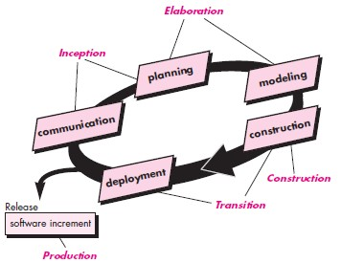
Unified Process
50

Slide 54
2) Elaboration Phase
The elaboration phase encompasses the communication and modeling activities of the generic process model.
Elaboration refines and expands the preliminary use cases that were developed as part of the inception phase and expands the architectural representation to include five different views of the software—the use case model, the requirements model, the design model, the implementation model, and the deployment model. In some cases, elaboration creates an “executable architectural baseline”.
52

Slide 55
3) Construction Phase
The construction phase of the UP is identical to the construction activity defined for the generic software process.
Using the architectural model as input, the construction phase develops or acquires the software components that will make each use case operational for end users.
To accomplish this, requirements and design models that were started during the elaboration phase are completed to reflect the final version of the software increment.
53

Slide 56
4) Transition Phase
The transition phase of the UP encompasses (delivery and feedback) activity.
Software is given to end users for beta testing and user feedback reports both defects and necessary changes.
In addition, the software team creates the necessary support information (e.g., user manuals, troubleshooting guides, installation procedures) that is required for the release. At the conclusion of the transition phase, the software increment becomes a usable software release.

Slide 57

5) Production Phase
The production phase of the UP coincides with the deployment activity of the generic process.
During this phase, the ongoing use of the software is monitored, support for the operating environment (infrastructure) is provided, and defect reports
and requests for changes are submitted and evaluated.

Slide 58
There are two broad categories of UML diagrams −
Structural Diagrams
Behavioral Diagrams
1) Structural Diagrams
The structural diagrams represent the static aspect of the system. These static aspects represent those parts of a diagram, which forms the main structure and are therefore stable.
These static parts are represented by classes, interfaces, objects, components, and nodes. The four structural diagrams are −
Class diagram
Object diagram
Component diagram
Deployment diagram

Slide 59
2) Behavioral Diagrams
Any system can have two aspects, static and dynamic. So, a model is considered as complete when both the aspects are fully covered.
Behavioral diagrams basically capture the dynamic aspect of a system. Dynamic aspect can be further described as the changing/moving parts of a system.
UML has the following five types of behavioral diagrams −
Use case diagram
Sequence diagram
Collaboration diagram
State chart diagram
Activity diagram

Slide 60

What is Agility?
Meaning : able to move quickly and easily
Effective response to changes
Effective communication among all stakeholders
Drawing the customer onto the team; eliminate the “us and them” attitude
Organizing a team so that it is in control of the work performed
Rapid, incremental delivery of software
56

Slide 61
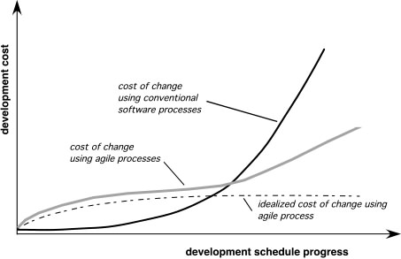
Agility and the Cost of Change

Slide 62
Agile software engineering combines a philosophy and a set of development guidelines.
The philosophy encourages customer satisfaction and early incremental delivery of software; small, highly motivated project teams; informal methods; minimal software engineering work products; and overall development simplicity.
The development guidelines stress delivery over analysis and design and active and continuous communication between developers and customers

Slide 63
Who does it?
Software engineers and other
project stakeholders (managers, customers, end users) work together on an agile team—a team that is self-organizing and in control of its own destiny.
An agile team fosters communication and collaboration among all who serve on it.

Slide 64
Why is it important?
The modern business environment
that uses computer-based systems and software products is fast-paced and ever changing.
Agile software engineering represents a reasonable alternative to conventional software engineering for certain classes of software and certain types of software projects. It has been demonstrated to deliver successful systems quickly.

Slide 65
What are the steps?
Agile development might best be termed “software engineering lite.”
The basic framework activities-Communication, Planning, Modeling, Construction and Deployment— remain same.
But they morph into a minimal task set
that pushes the project team toward construction and delivery).

Slide 66
What is the work product?
Both the customer and the software engineer have the same view—the only really important work product is an operational “software increment” that is delivered to the customer on the appropriate commitment date.
How do I ensure that I’ve done it right?
If the agile team agrees that the process works, and the team produces deliverable software increments that satisfy the customer, you’ve done it right.

Slide 67

Agile engineers believe
Current software development processes are too heavyweight or cumbersome
Too many things are done that are not directly related to software product being produced
Current software development is too rigid
Difficulty with incomplete or changing requirements
Short development cycles (Internet applications)
More active customer involvement needed
CMM (Capability Maturity Model) focuses on process
57

Slide 68
Agile methods are considered
Lightweight
People-based rather than Plan-based
Set of principles
Developed by Agile Alliance―Agile is dynamic, content specific, aggressively change embracing, and growth oriented
58

Slide 69

An Agile Process
Is driven by customer descriptions of what is required (scenarios)
Recognizes that plans are short-lived
Develops software iteratively with a heavy emphasis on construction activities
Delivers multiple software increments
Adapts as changes occur
Agile Methods
Scrum
Extreme Programming(XP)
Adaptive Software Development (ASD)
Dynamic System Development Method (DSDM), etc.
59

Slide 70

Agility Principles
Highest priority is to satisfy the customer through early and continuous delivery of valuable software.
Welcome changes from customer at anytime in the process.
Deliver working software frequently
4.Business people and developers must work together daily throughout the project.
5.Build projects around motivated individuals.
Have face-to-face conversation.
Working software is the primary measure of progress.
60

Slide 71
8. The sponsors, developers, and users should be able to maintain a constant pace indefinitely.
9. Continuous attention to technical excellence and good design enhances agility.
10. The best architectures, requirements, and designs emerge from self–organizing teams.
At regular intervals, team tune up and adjust behavior accordingly

Slide 72

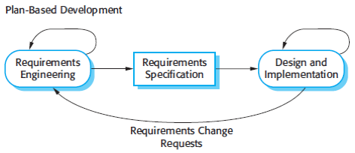
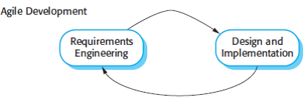
Plan-driven and agile development
Plan Driven Approach | Agile Approach
Plan Driven Approach identifies separate stages in the software process with outputs associated with each stage | Agile approach consider design and implementation to be the central activities in the software process
Iteration occurs within activities. | Iteration occurs across activities.
Supports incremental development and delivery. | Not code-focused and end up producing a design document
61

Slide 73

Agile Methodologies
1) Kanban - Kanban is a simple, visual means of managing projects that emphasizes visibility.
Kanban is a workflow management method for defining, managing, and improving services that deliver knowledge work. It aims to help you visualize your work, maximize efficiency, and improve continuously.

Slide 74
2) Scrum –
It is a framework for project management that emphasizes teamwork, accountability and iterative progress toward a well-defined goal. ... The three pillars of Scrum are Transparency, Inspection and Adaptation.
Scrum focuses on breaking a project down into sprints, and only planning and managing one sprint at a time. Scrum also has unique project roles, including a scrum master and Product Owner.

Slide 75
Extreme Programming -
Extreme Programming (XP) is an agile software development framework that aims to produce higher quality software, and higher quality of life for the development team.
XP is the most specific of the agile frameworks regarding appropriate engineering practices for software development.
It focuses on continuous development and customer delivery and uses intervals or sprints similar to a scrum methodology.

Slide 76
Agile Methodologies
Feature-Driven Development (FDD) - This methodology involved creating software models every two weeks and requires a development and design plan for every software model feature. Therefore, it has more rigorous documentation requirements than XP. FDD breaks projects down into five basic activities:
Develop an overall model
Build a feature list
Plan by feature
Design by feature
Build by feature

Slide 77

Dynamic Systems Development Method (DSDM) –
It cropped up out of the need to provide a common industry framework for rapid software delivery. Part of DSDM is the mandate that rework is to be expected, and any development changes that occur must be reversible.This framework is based on eight key principles:
Focus on the business need
Deliver on time
Collaborate
Never compromise quality
Build incrementally from firm foundations
Develop iteratively
Communicate continuously and clearly
Demonstrate control

Slide 78

Introduction to Agile Tools
The Objective is to help in one or more activities in agile development.
Automated support for project planning, use case development, requirement gathering, code generation and testing.
Project management tools focus on preparing
―Earned Value Charts‖ instead of preparing the Gantt Charts.
Purpose is to enhance the environment

Slide 79

JIRA
Developed by Atlassian in 2002.
Used for bug tracking, issue tracking and project management.
Inherited from Japanese word ―Gojira meaning Godzilla
JIRA is a competitor for Bugzilla.
Written in Java and used for Project Management activities.
Features:
Plan development iterations
Iteration reports
Bug tracking
JIRA Issues:
It is a part of JIRA tool which is used to track bugs in the project.
JIRA Components
Sub-sections of project
Used to group issues into smaller parts.
Projects can be broken down into features, teams, modules, sub-projects, etc.
We can generate reports, collect statistics and display it on dashboards

Slide 80
JIRA
Reports in JIRA
Progress of the project can be represented using BurndownChart.
Different reports like Sprint Report, Version Report, Control Chart, Cumulative flow diagram, etc. are also available.

Slide 81
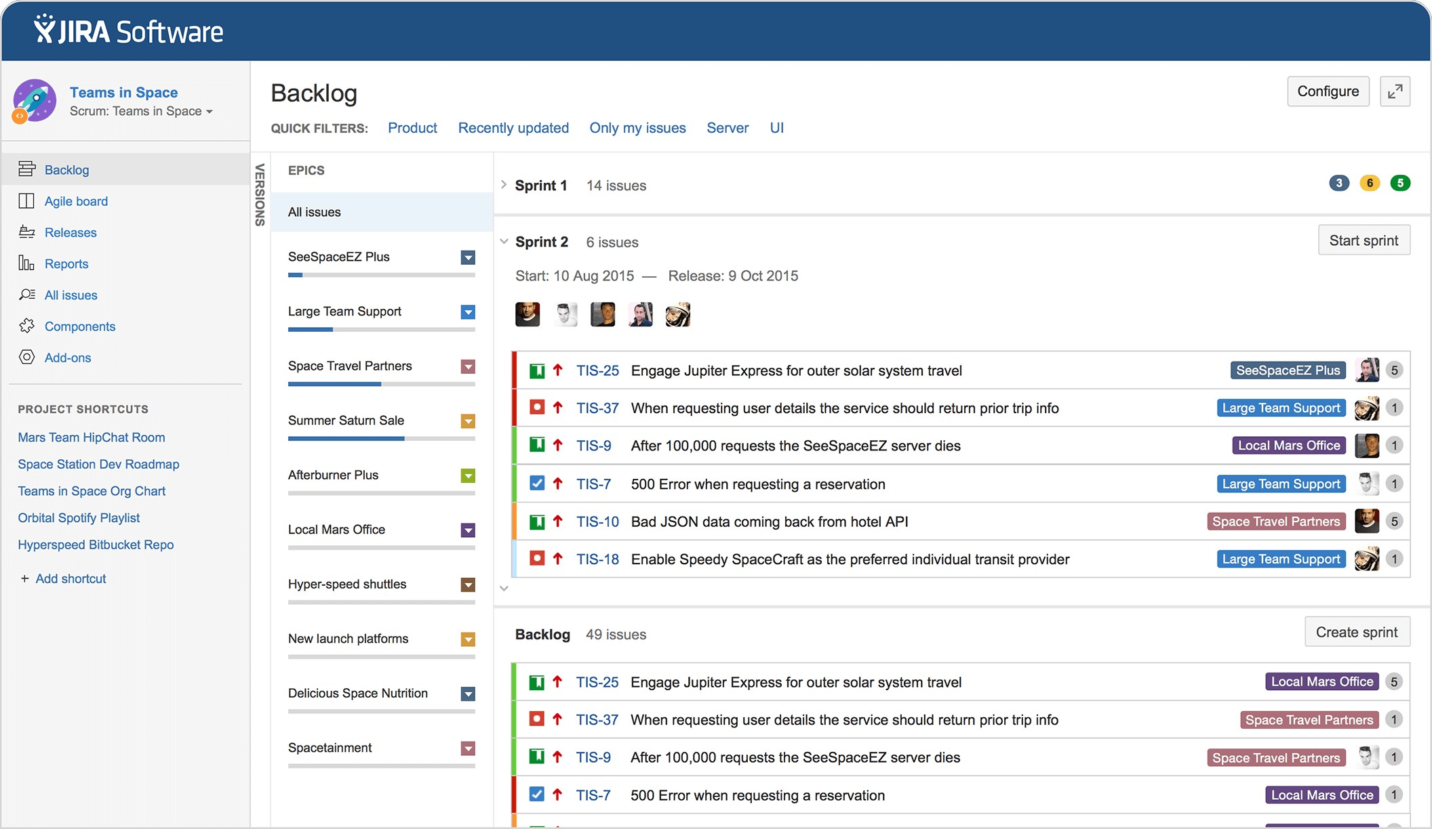

Slide 82

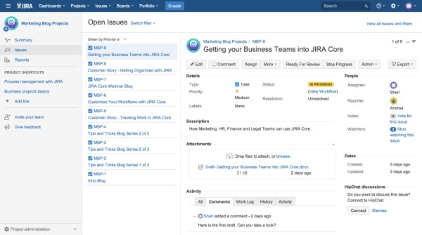

Slide 83
